Slide 1


LEARNING STRIDES IN CONVOLUTIONAL NEURAL NETWORKS
LIGHTWEIGHT CONVOLUTIONAL NEURAL NETWORKS BY HYPERCOMPLEX PARAMETERIZATION
30th May 2022
Authors: Rachid Riad, Olivier Teboul, David Grangier & Neil Zeghidour
Authors: Eleonora Grassucci, Aston Zhang, Danilo Comminiello
Cocci Federica - 1802435
Santilli Sofia - 1813509
Professor: Aurelio Uncini
Tutor: Danilo Comminiello
Students:

Slide 2
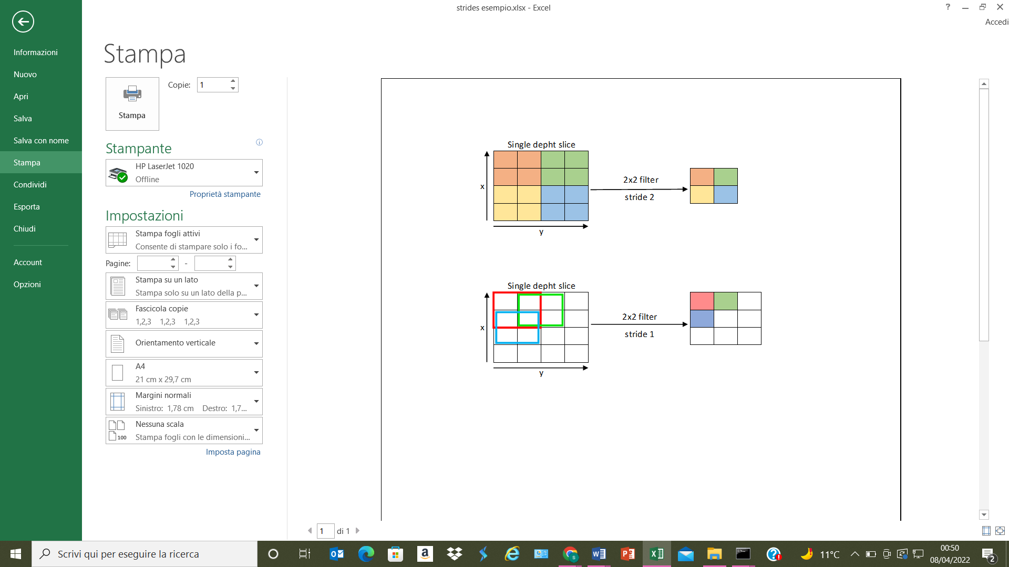
Problem statement
using Strides
Convolutional layers
extraction from the input data of a feature map
problem:
Location sensitive
solution:
Downsampling
Pooling layer

Slide 3




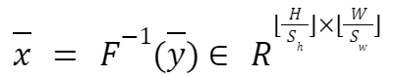
Fixed Spectral pooling
Having the input x and the strides S
the Discrete Fourier Transform of x is computed
the bounding box crops the input in the frequency domain
the output is brought back to the spatial domain, through the inverse DFT

Slide 4
Fixed Spectral pooling
Truncation in the frequency domain.
Flexibility:
Preservation of more information: it is a type of denoising.
Strides still an hyperparameter, not learnable
non-integer strides
more fine-grained downsizing

Slide 5
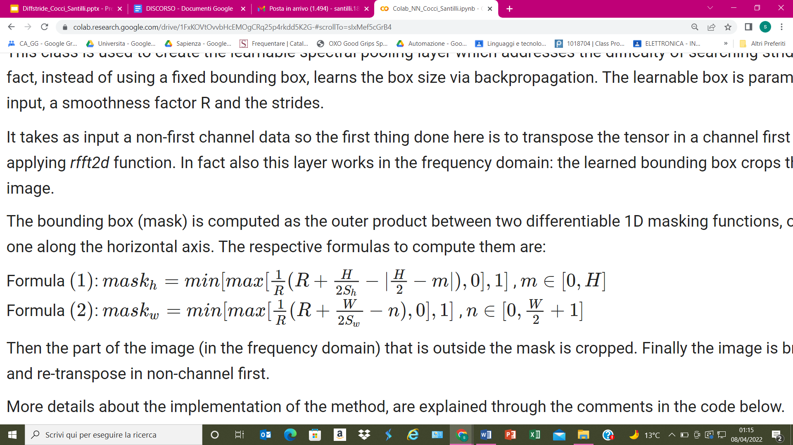
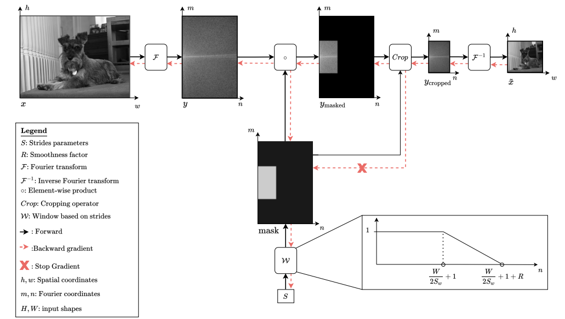
Diffstride (learnable strides)

Slide 6
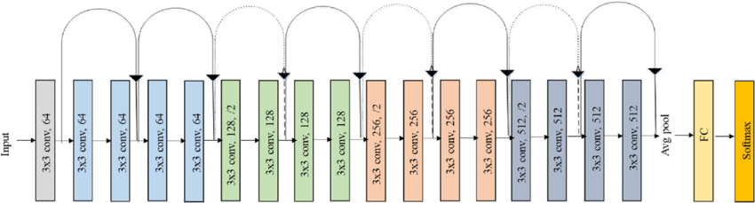
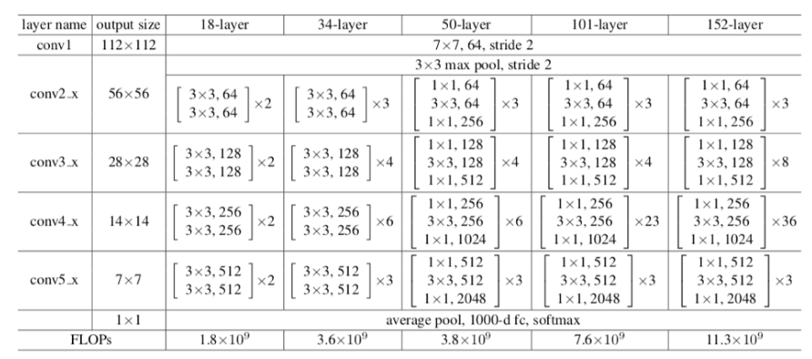
Network: ResNet-18

Slide 7
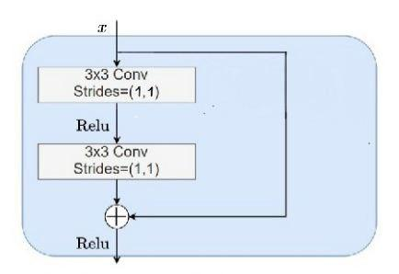
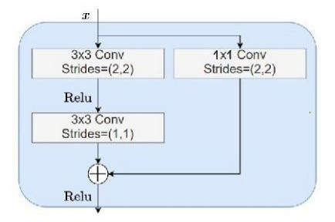
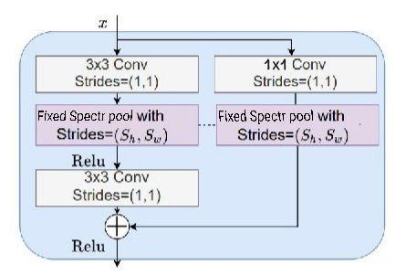
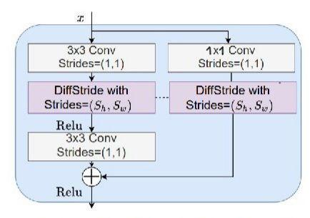
Identity and Residual blocks
Identity block
Residual block with a strided convolution
Residual block with a Fixed Spectral pooling layer
Residual block with a Diffstride layer

Slide 8
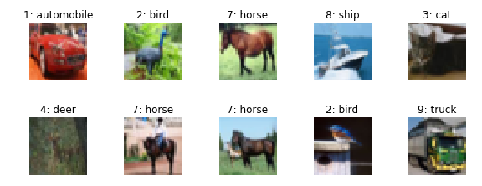
Dataset: CIFAR-10
60.000 coloured images 32x32
10 classes (6.000 images per class):
airplane, automobile, bird, cat, deer, dog, frog, horse, ship, truck
50.000 training images, 5.000 validation images, 5.000 test images

Slide 9
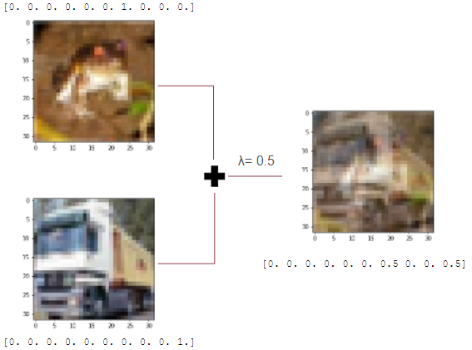
Preprocessing
normalization
mean=[0.4914, 0.4822, 0.4465]
std=[0.2470, 0.2435, 0.2616]
random cropping
random flipping left-to-right
mix up

Slide 10
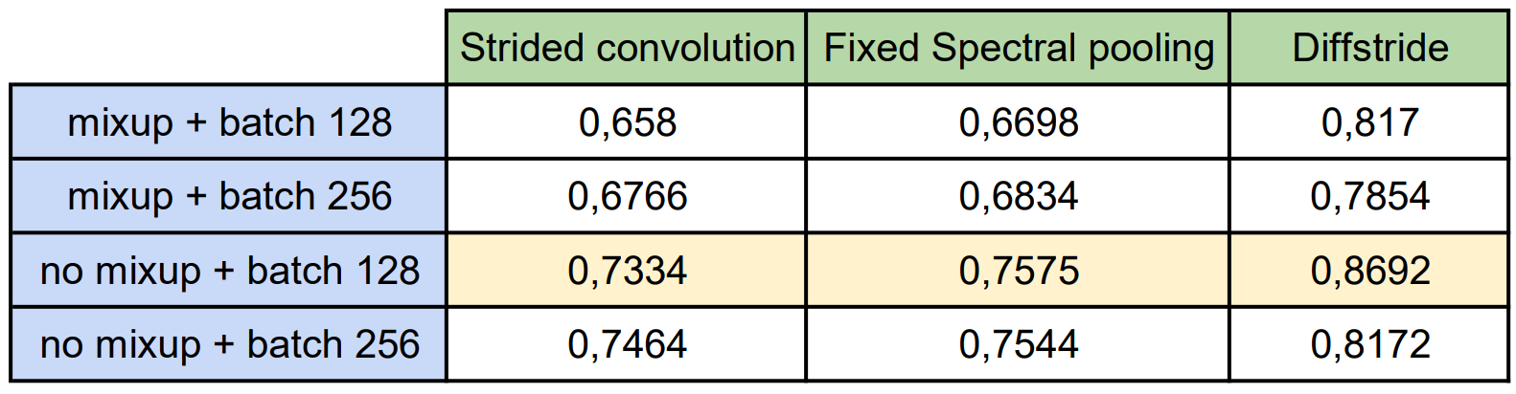
Experiments
Strides initialization for the 3 residual layers = (2, 2, 2)
We have used 150 epochs for strided convolution and fixed spectral pooling
We have used 40 epochs with early stopping for diffstride

Slide 11
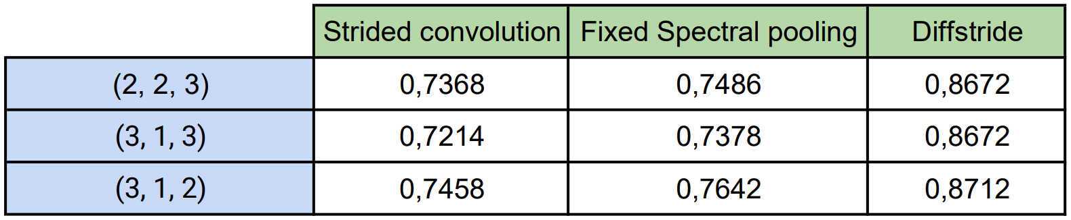
Other experiments and Conclusions
Running these experiments without mixup and batch of 128
pro: Diffstride outperforms the standard downsampling layers
contro: higher computational cost

Slide 12
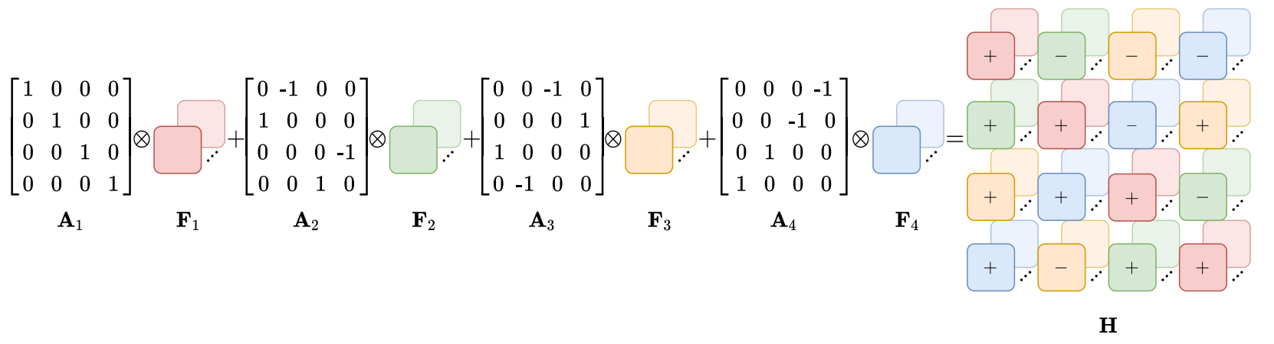
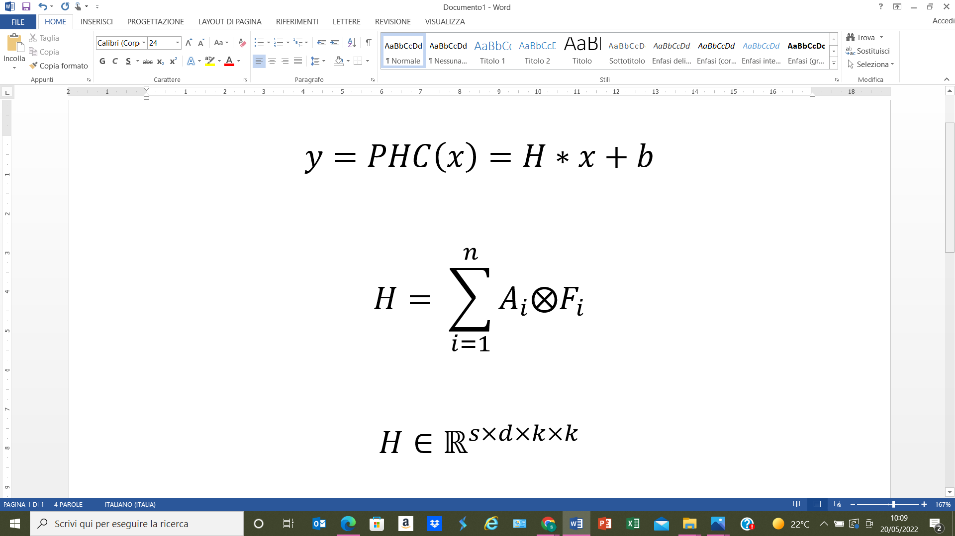
Additional implementation with PHC layer
PHC = parametrized hypercomplex convolution
Reduce the overall number of parameters by a factor N
From Pytorch to Tensorflow
Generalizes the hypercomplex multiplication as sum of Kronecker products between two learnable matrices:
s = input dimension
d = output dimension
k = filter size

Slide 13
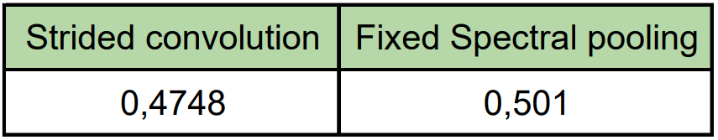
Experiments
PHC layer used instead of 2D convolutions
N = 3 → ⅓ parameters of the previous experiments
Strides initialization for the 3 residual layers = (2, 2, 2)
Dataset CIFAR 10
Also with PHC layers, downsampling the image in the frequency domain brings improvements in the accuracy

